Slide 1



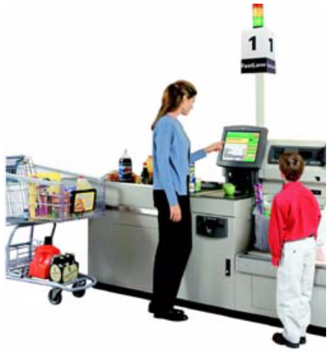
Big Data Everywhere!
Lots of data is being collected
and warehoused
  Web data, e-commerce
  purchases at department/
  grocery stores
  Social Network

Slide 2
Criteria of Big Data
272 hours of video are uploaded to YouTube every minute and over 3 billion hours of video are watched every month.
Radio Frequency ID (RFID) systems generated up to 1,000 times more data compared to the conventional bar code systems.
340 million tweets are sent every day and that amounts of 7TB of data.
Social networking site, Facebook, processes over 10TB of data every day.
Over 5 billion people use cell phones to call, send SMS, email, browse Internet, and interact via social networking sites.
The Square Kilometre Array project of NASA receives 700 TB of data per second.

Slide 3
Challenges with Big Data
Scaling is costly.
Strategy must be in place before you hit the limit of a single computer.
Most entreprises responded to scalability needs when they started facing problems of poor response and low throughput.
Adding hardware to existing system is manpower extensive and hence error prone.
Mixed data type - structured and unstructured - makes scaling even harder.

Slide 4
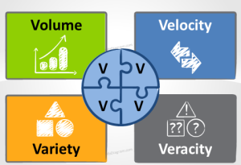
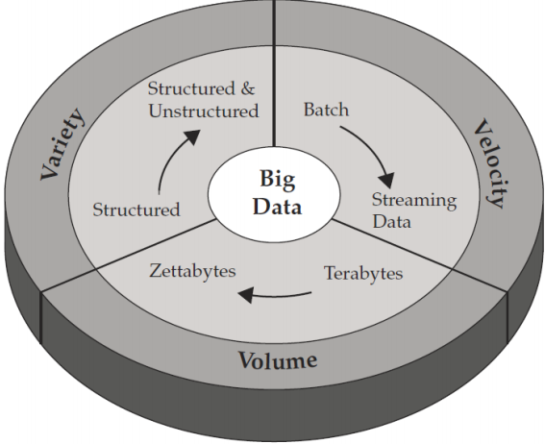
Big Data Technically
i. Volume
petta bytes or Zetta bytes.
ii. Velocity
Batch or real(stream) time processing.
iii. Variety
Structured, semi-structured & Unstructured.
It is estimated that 80% of world’s data are unstructured and rest of them semi-structured and structured.
Fig.Big Data Based on Doug Cutting 3Vs model

Slide 5
Variety of Data
1. Structured Data:- Data i.e. identifiable because its organized in a structure(Standard defined format)
E.g.: Database, Data Warehouses & Electronic spreadsheets.
2. Semi-Structured Data:- Data i.e. neither raw data, nor typed data in a conventional database system
E.g.: Wiki pages, Tweets, Facebook data & Instant Messages.
3. Unstructured Data:- its doesn’t have standard defined structure
E.g.: Data files, Audio files, Video, Graphics & Multimedia.

Slide 6
Traditional Data v/s Big Data
Attributes | Traditional Data | Big Data
Volume | Gigabytes to terabytes | Petabytes to zettabytes
Organizaton | Centralized | Distributed
Structure | Structured | Semi-structured & unstructured
Data model | Strict schema based | Flat schema
Data relationship | Complex interrelationships | Almost flat with few relationships

Slide 7
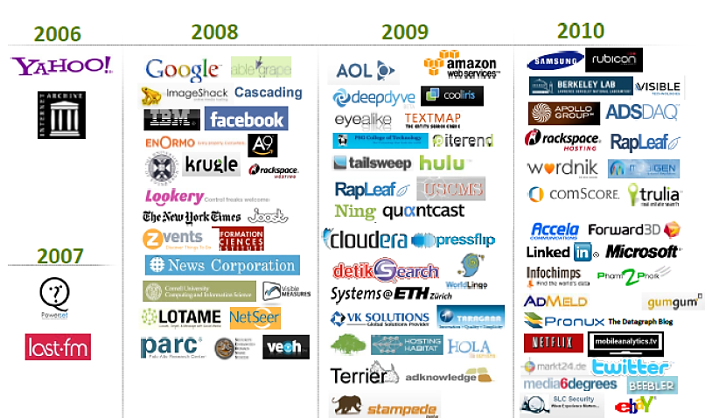
Organizations Adopted Big Data

Slide 8
An introduction to MongoDB

Slide 9
NOSQL
NoSQL (often interpreted as Not only SQL) database
It provides a mechanism for storage and retrieval of data that is modeled in means other than the tabular relations used in relational databases.

Slide 10






NoSQL
Graph database
Document-oriented
Column family

Slide 11
What is MongoDB?
MongoDB is an open source, document-oriented database designed with both scalability and developer agility in mind. Instead of storing your data in tables and rows as you would with a relational database, in MongoDB you store JSON-like documents with dynamic schemas(schema-free, schema less).

Slide 12
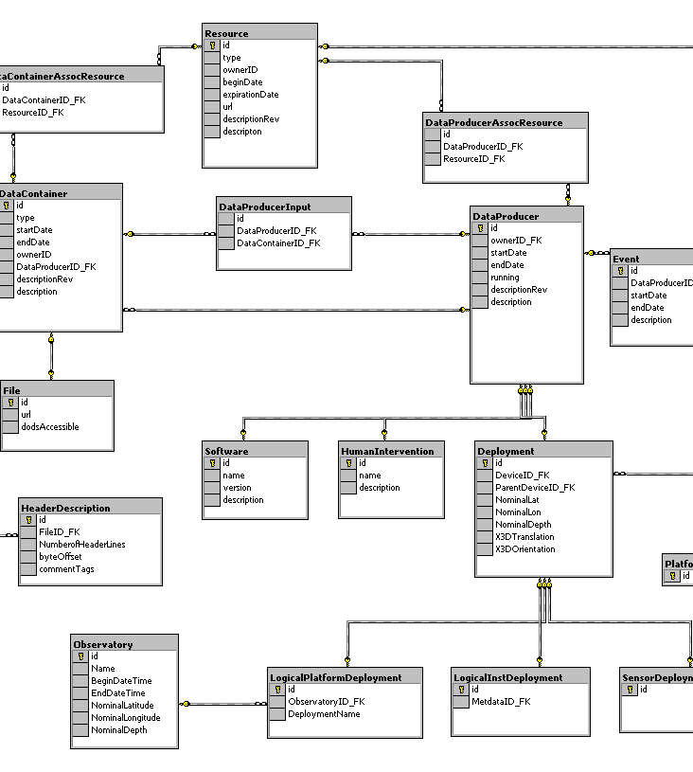
MongoDB is Easy to Use
{
title: ‘MongoDB’,
contributors: [
{ name: ‘Eliot Horowitz’,
email: ‘eliot@10gen.com’ },
{ name: ‘Dwight Merriman’,
email: ‘dwight@10gen.com’ }
],
model: {
relational: false,
awesome: true
}
}

Slide 13
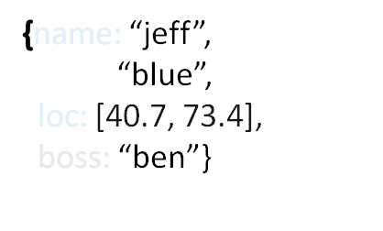



Schema Free
MongoDB does not need any pre-defined data schema
Every document could have different data!
{name: “will”,
eyes: “blue”,
birthplace: “NY”,
aliases: [“bill”, “la ciacco”],
loc: [32.7, 63.4],
boss: ”ben”}
{name: “brendan”,
aliases: [“el diablo”]}
{name: “matt”,
pizza: “DiGiorno”,
height: 72,
loc: [44.6, 71.3]}

Slide 14
Document store
RDBMS |  | MongoDB
Database |  | Database
Table, View |  | Collection
Row |  | Document (JSON, BSON)
Column |  | Field
Index |  | Index
Join |  | Embedded Document
Foreign Key |  | Reference
Notes:
Javascript

Slide 15
Document store
RDBMS |  | MongoDB
Database |  | Database
Table, View |  | Collection
Row |  | Document (JSON, BSON)
Column |  | Field
Index |  | Index
Join |  | Embedded Document
Foreign Key |  | Reference
Partition |  | Shard
> db.user.findOne({age:39})
{
"_id" : ObjectId("5114e0bd42…"),
"first" : "John",
"last" : "Doe",
"age" : 39,
"interests" : [
"Reading",
"Mountain Biking ]
"favorites": {
"color": "Blue",
"sport": "Soccer"}
}
Notes:
Flexible schema
Javascript

Slide 16
Features
Document-Oriented storege
Full Index Support
Replication & High Availability
Auto-Sharding
Querying
Fast In-Place Updates
Map/Reduce

Slide 17

Replication
Database

Slide 18
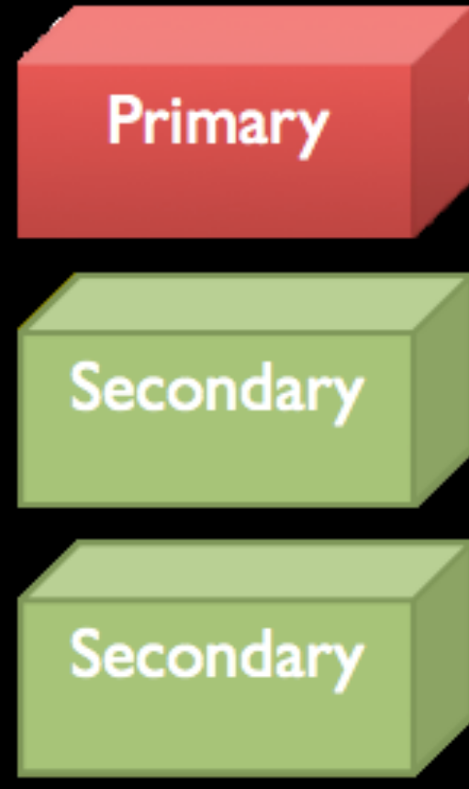
Replica Sets
Database
Database
Database

Slide 19
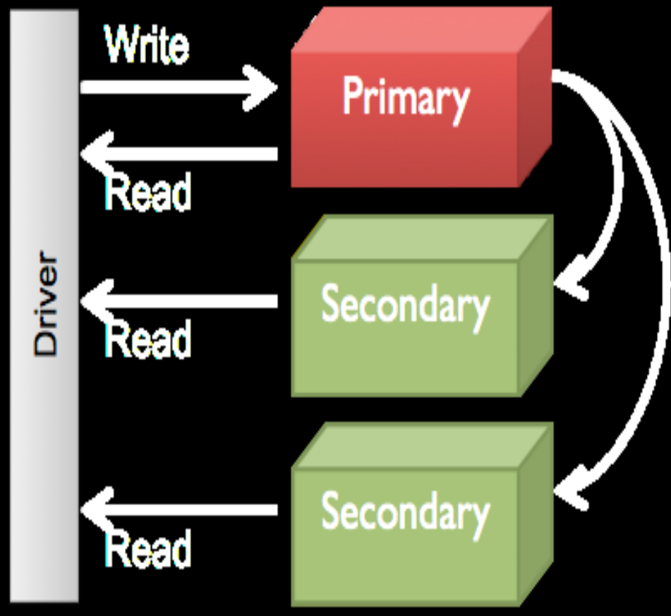
Replica Sets
Database
Asynchronous Replication
Database
Database

Slide 20
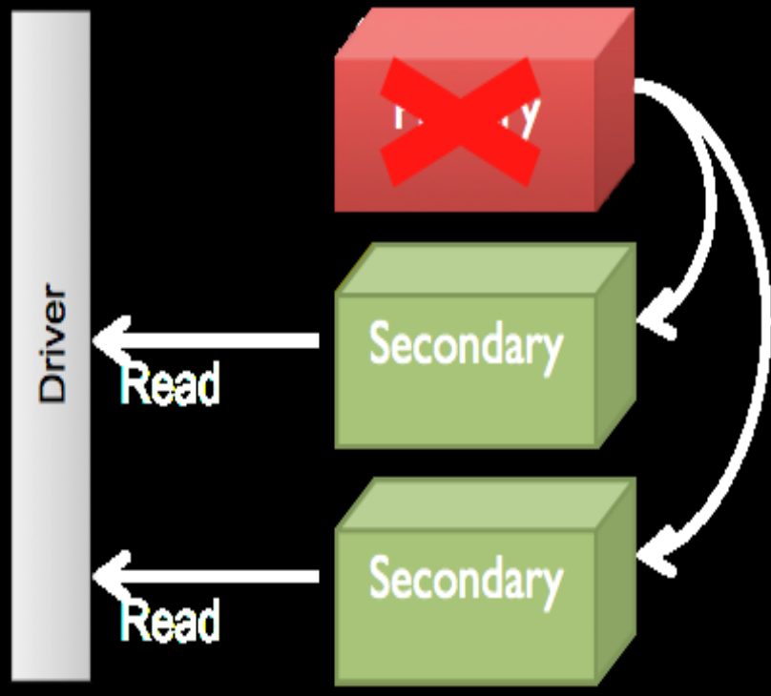
Replica Sets

Slide 21
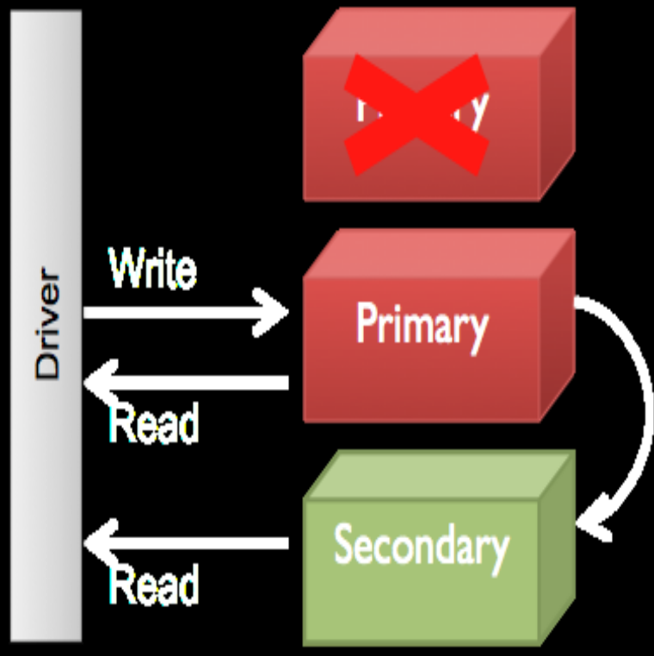
Replica Sets
Automatic Election

Slide 22
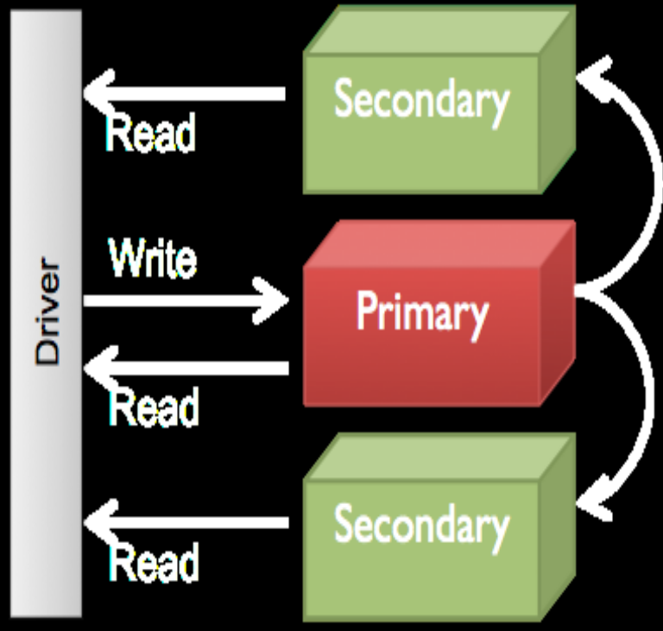
Replica Sets

Slide 23
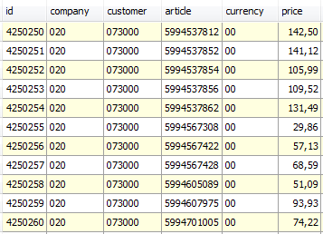
Sharding
Partition your data
Scale write throughput
Increase capacity
Auto-balancing
shard₁
shard₂
Host1:10000
Host2:10010
configdb
Host3:20000
Client
Host4:30000
Notes:
1970 – 2000: Vertical Scalability (scale-up)
Google, ~2000: Horizontal Scalability (scale-out)

Slide 24
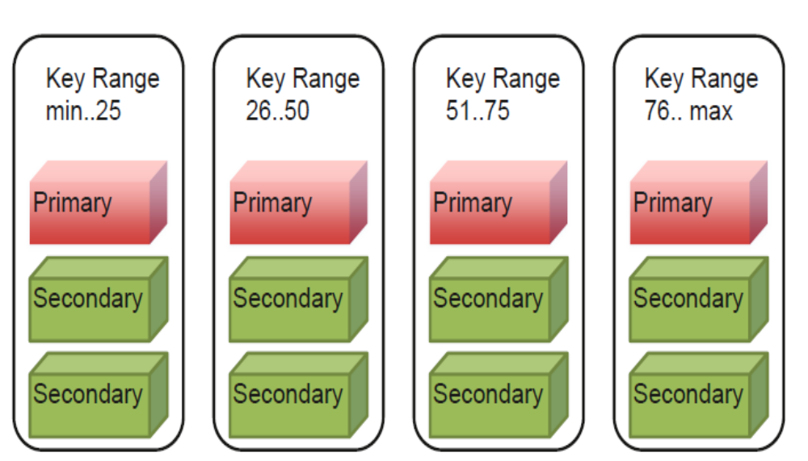
SHARDING

Slide 25
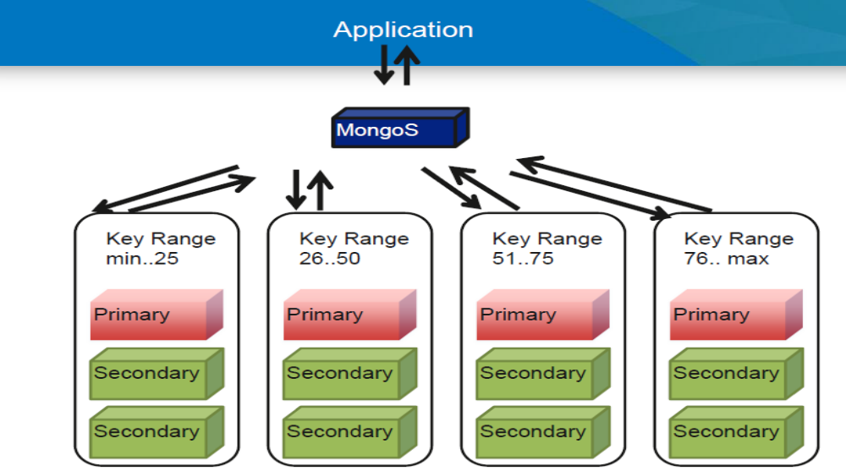
SHARDING

Slide 26
Other features
Easy to install and use
Detailed documentation
Various APIs
  JavaScript, Python, Ruby, Perl, Java, Java, Scala, C#, C++, Haskell, Erlang
Community
Open source

